Slide 1

PRESENTATION ON SECRET SHARING USING PIXEL GROUPING
Submitted by:
NAYAN GOSWAMI 25300120004
SHRUTI SINGH 25300120013
SWARNADIP GUIN 25300120014
SOUVIK BHATTACHARJEE 25300120019
ISHA MAJI 25300120029

Slide 2

SECRET SHARING USING PIXEL GROUPING
z

Slide 3

PREFACE
Why Encryption?
Cause
Utility
Effects

Slide 4

ENCRYPTION TECHNIQUES:
Cryptography
Steganography
Visual Cryptography
Secret Sharing scheme

Slide 5

CRYPTOGRAPHY
Conversion of data into a scrambled code
Transmitted
Public or private network.

Slide 6

STEGANOGRAPHY
Camouflaging of messages.

Slide 7



VISUAL CRYPTOGRAPHY
Hiding information in images.

Slide 8

WHAT IS SECRET SHARING?
Distribution of a secret amongst a group of participants.
The secret can only be reconstructed when the shares are combined together; individual shares are of no use on their own.

Slide 9

WHY DO WE NEED SECRET SHARING?
Gives tight control and removes single point vulnerability.
To ensure security- confidentiality, authenticity and integrity.
Individual key share holder cannot change/access the data.

Slide 10

OUR ALGORITHMS
ONE PIXEL SHARING ALGORITHM
THREE PIXEL SHARING ALGORITHM

Slide 11

THE PROPOSED SCHEME
Pixel division
Key generation stage (random matrices)
Share construction
Share collection
Image reconstruction

Slide 12

ONE PIXEL SHARING ALGORITHM
z

Slide 13

PIXEL DIVISION
1st pixel value is 160
8 bit value of a single pixel being grouped into sub pixels of two bits each.
1ST 2ND 3RD 4TH
10 | 10 | 00 | 00

Slide 14
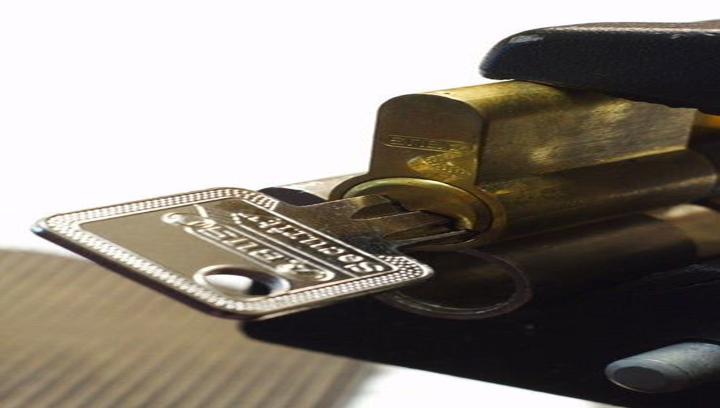
KEY GENERATION
R1 R2
00 01 10 11 00 01 10 11
00
01
10
11
47 | 230 | 182 | 33
214 | 168 | 172 | 233
142 | 171 | 6 | 164
8 | 194 | 98 | 251
58 | 223 | 34 | 223
61 | 56 | 147 | 204
25 | 73 | 94 | 59
73 | 62 | 103 | 164

Slide 15

SHARE GENERATION
Generate 2 shares(S1, S2)
1st Share:- 1st Sub pixel 3rd Sub pixel
2nd Share:- 2nd Sub pixel 4th Sub pixel

Slide 16

SHARE CONSTRUCTION
R1
00 01 10 11
00
01
10
11
10 | 10 | 00 | 00
1ST 2ND 3RD 4TH
8 bit value of the 1st Pixel
47 | 230 | 182 | 33
214 | 168 | 172 | 233
142 | 171 | 6 | 164
8 | 194 | 98 | 251

Slide 17

SHARE CONSTRUCTION (cont.)
R2
00 01 10 11
00
01
10
11
10 | 10 | 00 | 00
1ST 2ND 3RD 4TH
8 bit value of the 1st Pixel
58 | 223 | 34 | 223
61 | 56 | 147 | 204
25 | 73 | 94 | 59
73 | 62 | 103 | 164

Slide 18

SHARE CONSTRUTED
S1 S2
1 2 3 4 1 2 3 4
1
2
3
4
142 | 135 | 108 | 133
192 | 149 | 117 | 179
164 | 112 | 197 | 138
201 | 125 | 155 | 164
25 | 73 | 73 | 73
25 | 25 | 73 | 73
204 | 25 | 25 | 25
204 | 204 | 204 | 204

Slide 19

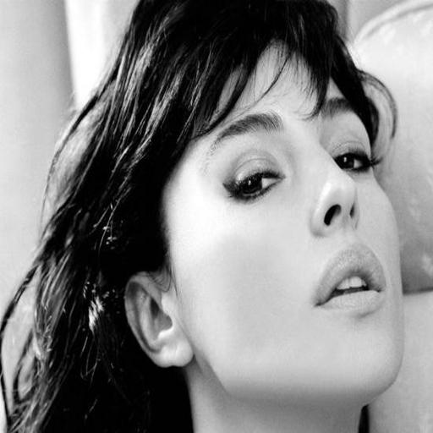
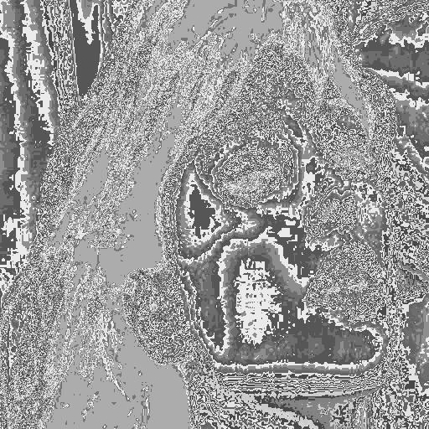
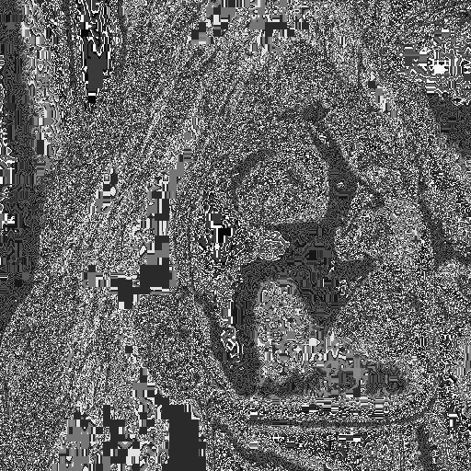
OBTAINED SHARES
IMAGE
SHARE 1
SHARE 2

Slide 20

IMAGE RECONSTRUCTION
S1
1 2 3 4
1
2
3
4 upto n x n
142 | 135 | 108 | 133
192 | 149 | 117 | 179
164 | 112 | 197 | 138
201 | 125 | 155 | 164

Slide 21

IMAGE RECONSTRUCTION
1ST 2ND 3RD 4TH
00
01
10
11
10 | 10 | 00 | 00
00 01 10 11
47 | 230 | 182 | 33
214 | 168 | 172 | 233
142 | 171 | 6 | 164
8 | 194 | 98 | 251

Slide 22


RECONSTRUCTED IMAGE
SHARE 1
SHARE 2
RECONSTRUCTED IMAGE

Slide 23

ADVANTAGES
Better regeneration of image.
Less complexity involved.
Higher value of PSNR.

Slide 24

DISADVANTAGES
Risks involved.
Less secure than Three Pixel Sharing Algorithm.

Slide 25

THREE PIXEL SHARING ALGORITHM

Slide 26

KEY GENERATION
R1
000 001 010 011 100 101 110 111
000
001
010
011
100
101
110
111
44 | 171 | 54 | 121 | 1 | 200 | 112 | 83
243 | 192 | 174 | 216 | 167 | 151 | 136 | 49
243 | 186 | 120 | 22 | 94 | 237 | 167 | 162
186 | 20 | 135 | 181 | 222 | 58 | 239 | 185
176 | 75 | 1 | 72 | 2 | 22 | 190 | 71
103 | 168 | 141 | 159 | 116 | 63 | 239 | 47
224 | 14 | 41 | 183 | 76 | 22 | 148 | 111
139 | 197 | 243 | 66 | 155 | 90 | 55 | 221

Slide 27

PIXEL DIVISION
Three 8 Bit pixels concatenated together to form 24 bits.
1ST 2ND 3RD 4TH 5TH 6TH 7TH 8TH
3 bits being grouped together to form 8 subdivisions (sub pixels).
101 | 000 | 001 | 010 | 000 | 110 | 100 | 001

Slide 28

SHARE GENERATION
Generate 4 shares(S1, S2, S3, S4) with row and column values as follows:-
Row Column
1st Share:- 1st Sub pixel 3rd Sub pixel
2nd Share:- 2nd Sub pixel 4th Sub pixel
3rd Share:- 5th Sub pixel 7th Sub pixel
4th Share:- 6th Sub pixel 8th Sub pixel

Slide 29
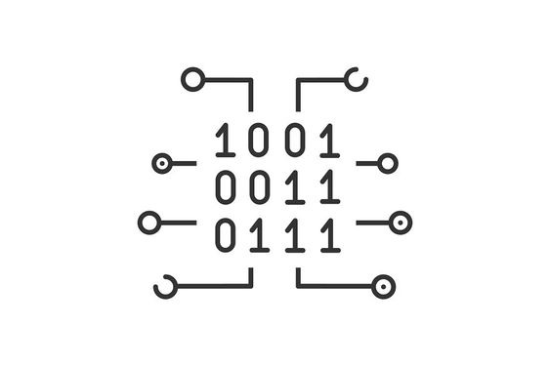
SHARE CONSTRUCTION
1ST Sub pixel = 101(row)
3rd Sub pixel = 001(column)

Slide 30

SHARE CONSTRUCTION(Contd.)
101 | 000 | 001 | 010 | 000 | 110 | 100 | 001
1ST 2ND 3RD 4TH 5TH 6TH 7TH 8TH
000 001 010 011 100 101 110 111
44 | 171 | 54 | 121 | 1 | 200 | 112 | 83
243 | 192 | 174 | 216 | 167 | 151 | 136 | 49
243 | 186 | 120 | 22 | 94 | 237 | 167 | 162
186 | 20 | 135 | 181 | 222 | 58 | 239 | 185
176 | 75 | 1 | 72 | 2 | 22 | 190 | 71
103 | 168 | 141 | 159 | 116 | 63 | 239 | 47
224 | 14 | 41 | 183 | 76 | 22 | 148 | 111
139 | 197 | 243 | 66 | 155 | 90 | 55 | 221
000
001
010
011
100
101
110
111

Slide 31

SHARE GENERATION
Size of share (n x (n/3)) != Size of image (n x n)
S1
1 2
1
2
3
4
5
6
168

Slide 32






OBTAINED SHARES
S1 S2 S3 S4

Slide 33

IMAGE RECONSTRUCTION
Size of share (n x (n/3)) != Size of image (n x n)
S1
1 2
1
2
3
4
5
6
168

Slide 34

IMAGE RECONSTRUCTION(Contd.)
101 |  | 001
1ST 2ND 3RD 4TH 5TH 6TH 7TH 8TH
000 001 010 011 100 101 110 111
44 | 171 | 54 | 121 | 1 | 200 | 112 | 83
243 | 192 | 174 | 216 | 167 | 151 | 136 | 49
243 | 186 | 120 | 22 | 94 | 237 | 167 | 162
186 | 20 | 135 | 181 | 222 | 58 | 239 | 185
176 | 75 | 1 | 72 | 2 | 22 | 190 | 71
103 | 168 | 141 | 159 | 116 | 63 | 239 | 47
224 | 14 | 41 | 183 | 76 | 22 | 148 | 111
139 | 197 | 243 | 66 | 155 | 90 | 55 | 221
000
001
010
011
100
101
110
111

Slide 35

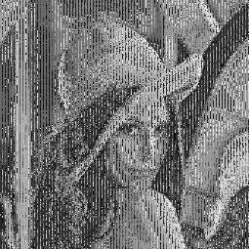
OBTAINED SHARES
S1
S3
S2
S4
RECONSTRUCTED IMAGE

Slide 36

PSNR VALUES OBTAINED
Image Name: | PSNR Values:
Lena.jpg | 31.55dB
Lady.jpg | 30.85dB
Child.jpg | 31.17dB
Fly.jpg | 31.25dB
Cameraman.jpg | 31.43dB
Duck.jpg | 30.57dB
Airplane.jpg | 30.42dB

Slide 37

ADVANTAGE
Highly secure.
Size of generated shares(n x (n/3)).
Regeneration possible if all shares involved.

Slide 38
DISADVANTAGE
Slightly irregular regenerated image.
More complexity involved.

Slide 39

CONCLUSION
ACHIEVMENTS.
LIMITATIONS.
FUTURE SCOPE.

Slide 40

ACHIEVMENTS
HASSLE FREE METHODOLOGY.
SIMPLE MAINTAINANCE AND IMPLEMENTATION.
SECURITY ENSURED.
RETRIVABLE.

Slide 41

LIMITATIONS
Limited resources may hinder scalability and future expansion.

Slide 42

FUTURE SCOPE
APPLICATIBLE TO COLOUR IMAGES.
IMPROVISATION OF KEYS.
SECURITY ENHANCEMENT.
MERGING WITH COVER MEDIA.

Slide 43

.

